Slide 1
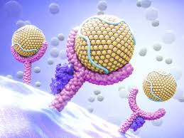
University of Basrah Al-zahra college of medicine
Ministry of higher Education and Scientific Research
Academic year 2021-2022 \ S 3
MEMBRANES AND RECEPTORSMODULE
SESSION 10: LECTURE: 1
DURATION: 1hr
Drugs and Autonomic nervous system
Module staff:
Dr. Sarah Mohammed Dr Nehaya M. Al-Aubody (Module leader) Dr Hamid J. Abbas Asst. Lecturer Eatidal Akram
Dr Ahmed Bader Dr Maida A. Adnan
Dr Amani N. Mohammed Dr. Firas Mohammed
Dr Zainab A. Almnaseer Dr. Amer Qassim
Dr.Zainab Muzahem Dr. Mohammed Adel
References :
1- MKSAP 18
2- Davidson text book of internal medicine 23rd edition

Slide 2
University of Basrah Al-zahra college of medicine
Ministry of higher Education and Scientific Research
Learning Outcomes
Know the effect of autonomic nervous system stimulation on various system.
To know some details about clinical disease.
Knowing the pathophysiological changes of these disease.
To know some guideline about the management of these disease.
knowing some clinical application of autonomic drugs.

Slide 3
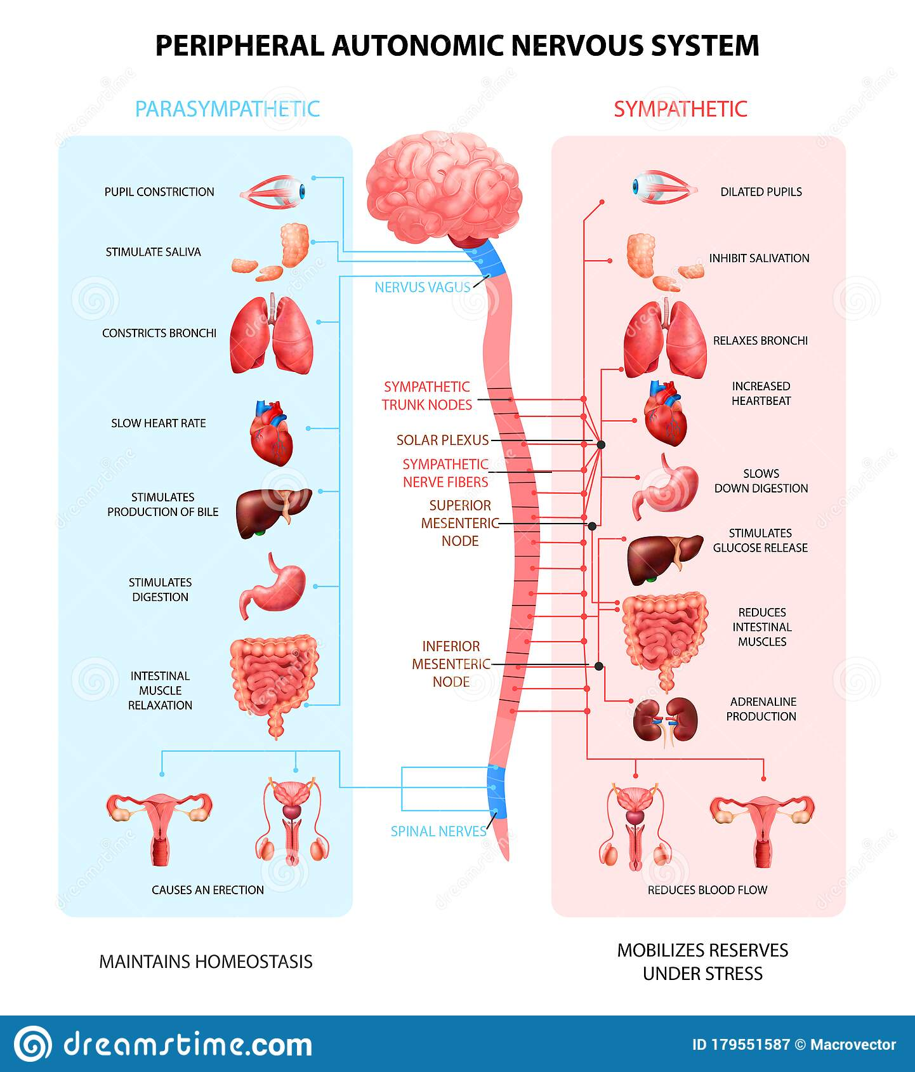
University of Basrah Al-zahra college of medicine
Ministry of higher Education and Scientific Research

Slide 4
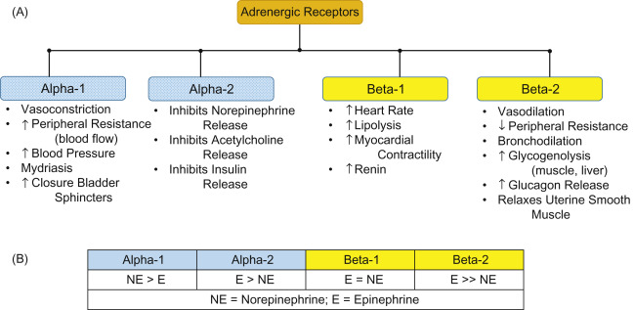
University of Basrah Al-zahra college of medicine
Ministry of higher Education and Scientific Research

Slide 5
University of Basrah Al-zahra college of medicine
Ministry of higher Education and Scientific Research
Some common clinical application of autonomic receptors agonist and antagonist:
Obstructive air way disease
Ischaemic heart disease (already discussed in CVS )
Arrhythmias (already discussed in CVS)
others

Slide 6
University of Basrah Al-zahra college of medicine
Ministry of higher Education and Scientific Research
We have two major types of air way disease :
Obstructive air way disease which mainly include:
Bronchial asthma .
Chronic obstructive air way disease.
Restrictive air way disease such as ( lung fibrosis , occupation air way disease ..etc).

Slide 7
University of Basrah Al-zahra college of medicine
Ministry of higher Education and Scientific Research
Bronchial asthma:
Asthma is a chronic inflammatory disorder of the airways, in which many cells and cellular elements play a role.
Chronic inflammation is associated with airway hyper-responsiveness that leads to recurrent episodes of wheezing, breathlessness, chest tightness and coughing, particularly at night and in the early morning.
These episodes are usually associated with widespread but variable airflow obstruction within the lung that is often reversible, either spontaneously or with treatment.

Slide 8
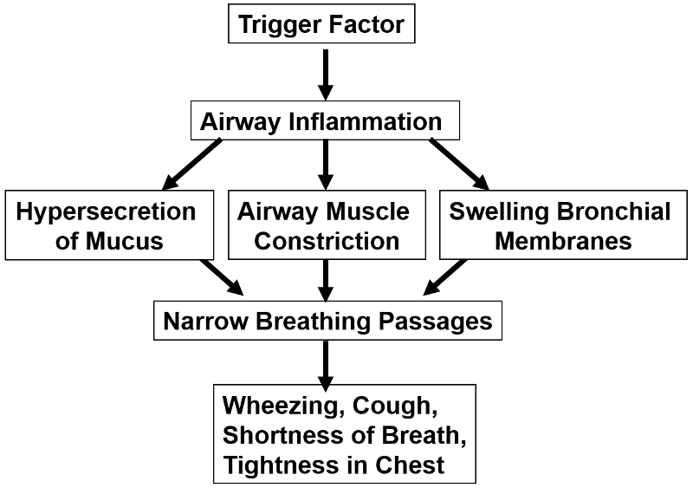
University of Basrah Al-zahra college of medicine
Ministry of higher Education and Scientific Research

Slide 9
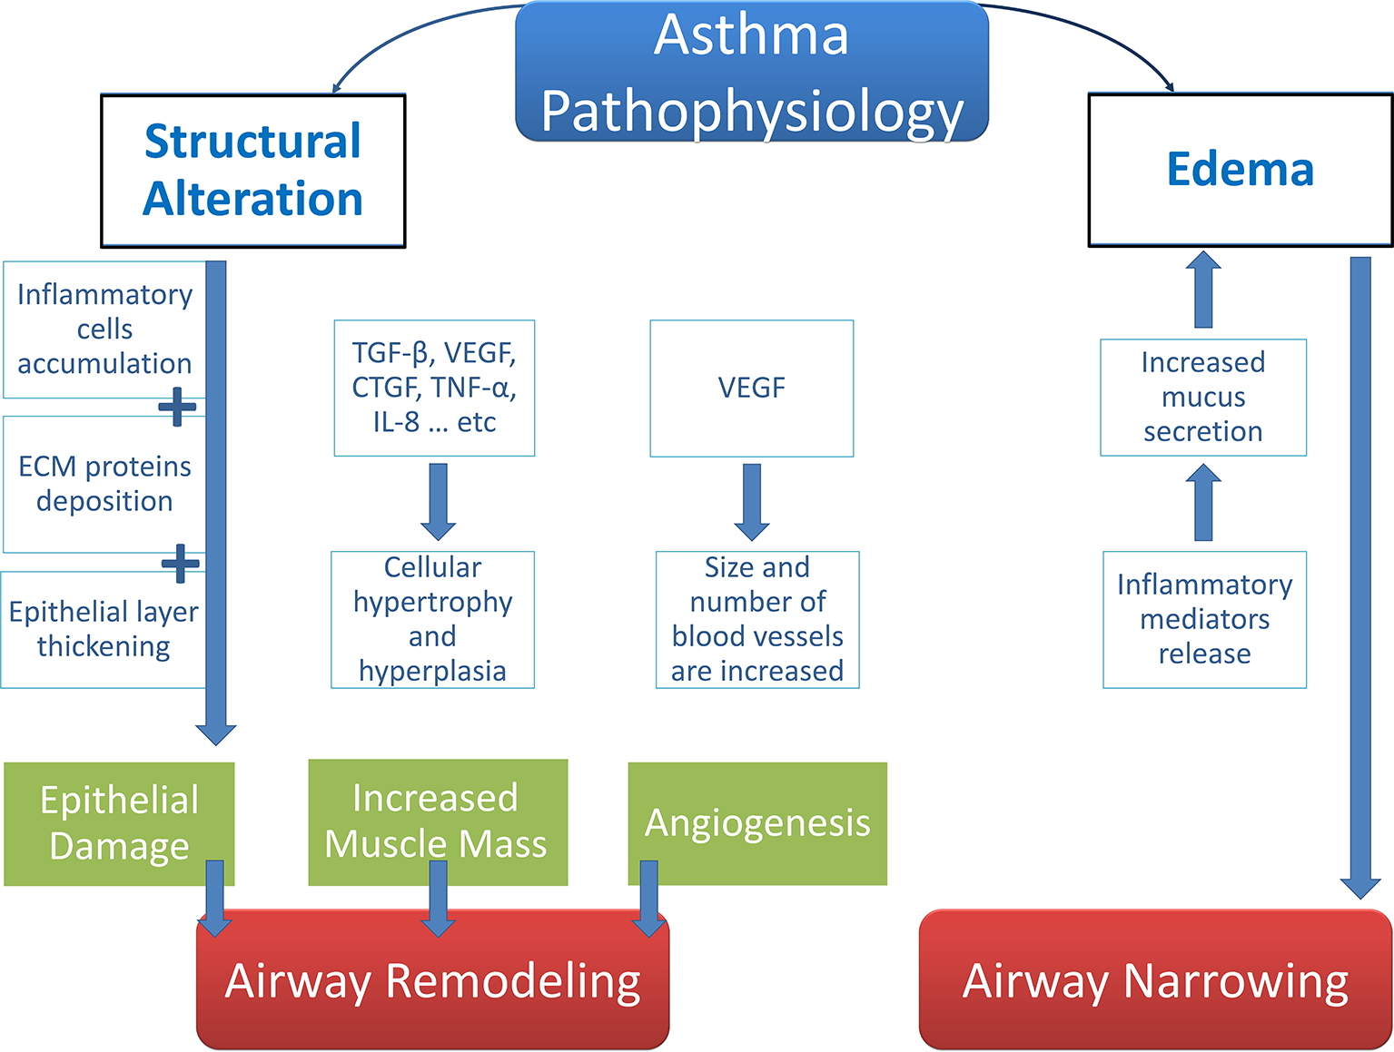
University of Basrah Al-zahra college of medicine
Ministry of higher Education and Scientific Research

Slide 10
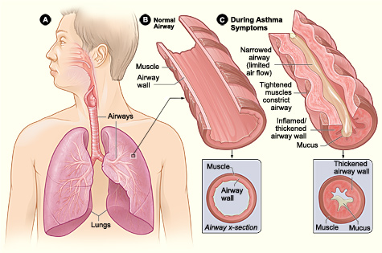
University of Basrah Al-zahra college of medicine
Ministry of higher Education and Scientific Research

Slide 11
University of Basrah Al-zahra college of medicine
Ministry of higher Education and Scientific Research
Asthma syndromes(clinical types):
Allergic asthma.
Cough variant asthma.
Exercise induce bronchospasm.
Occupation asthma.
Reactive airway dysfunction syndrome.
Aspirin exacerbated respiratory disease.
Allergic bronchopulmonary aspergillosis.

Slide 12
University of Basrah Al-zahra college of medicine
Ministry of higher Education and Scientific Research
Symptoms of asthma:
Cough
Wheeze
Chest tightness
Shortness of breath
Investigations:
Spirometry

Slide 13
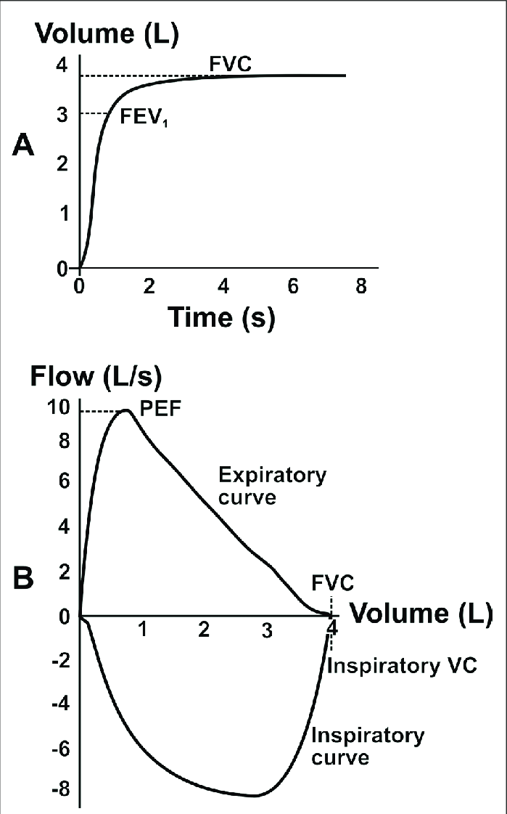
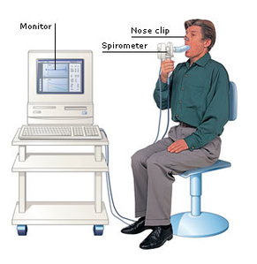
University of Basrah Al-zahra college of medicine
Ministry of higher Education and Scientific Research

Slide 14
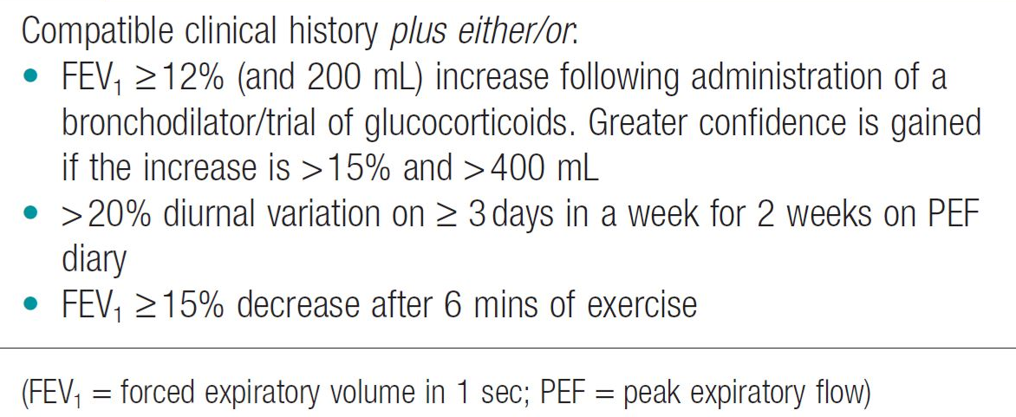
University of Basrah Al-zahra college of medicine
Ministry of higher Education and Scientific Research
Diagnosis of asthma

Slide 15
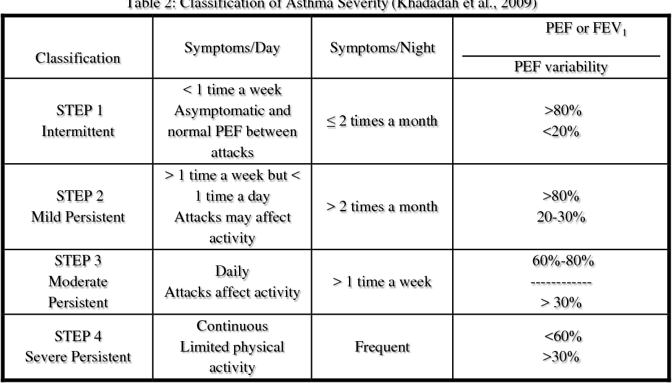
Classification of asthma severity
University of Basrah Al-zahra college of medicine
Ministry of higher Education and Scientific Research

Slide 16
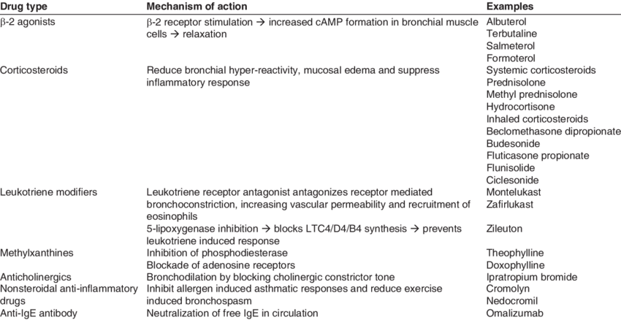
University of Basrah Al-zahra college of medicine
Ministry of higher Education and Scientific Research
Drugs used in treatment of asthma :

Slide 17
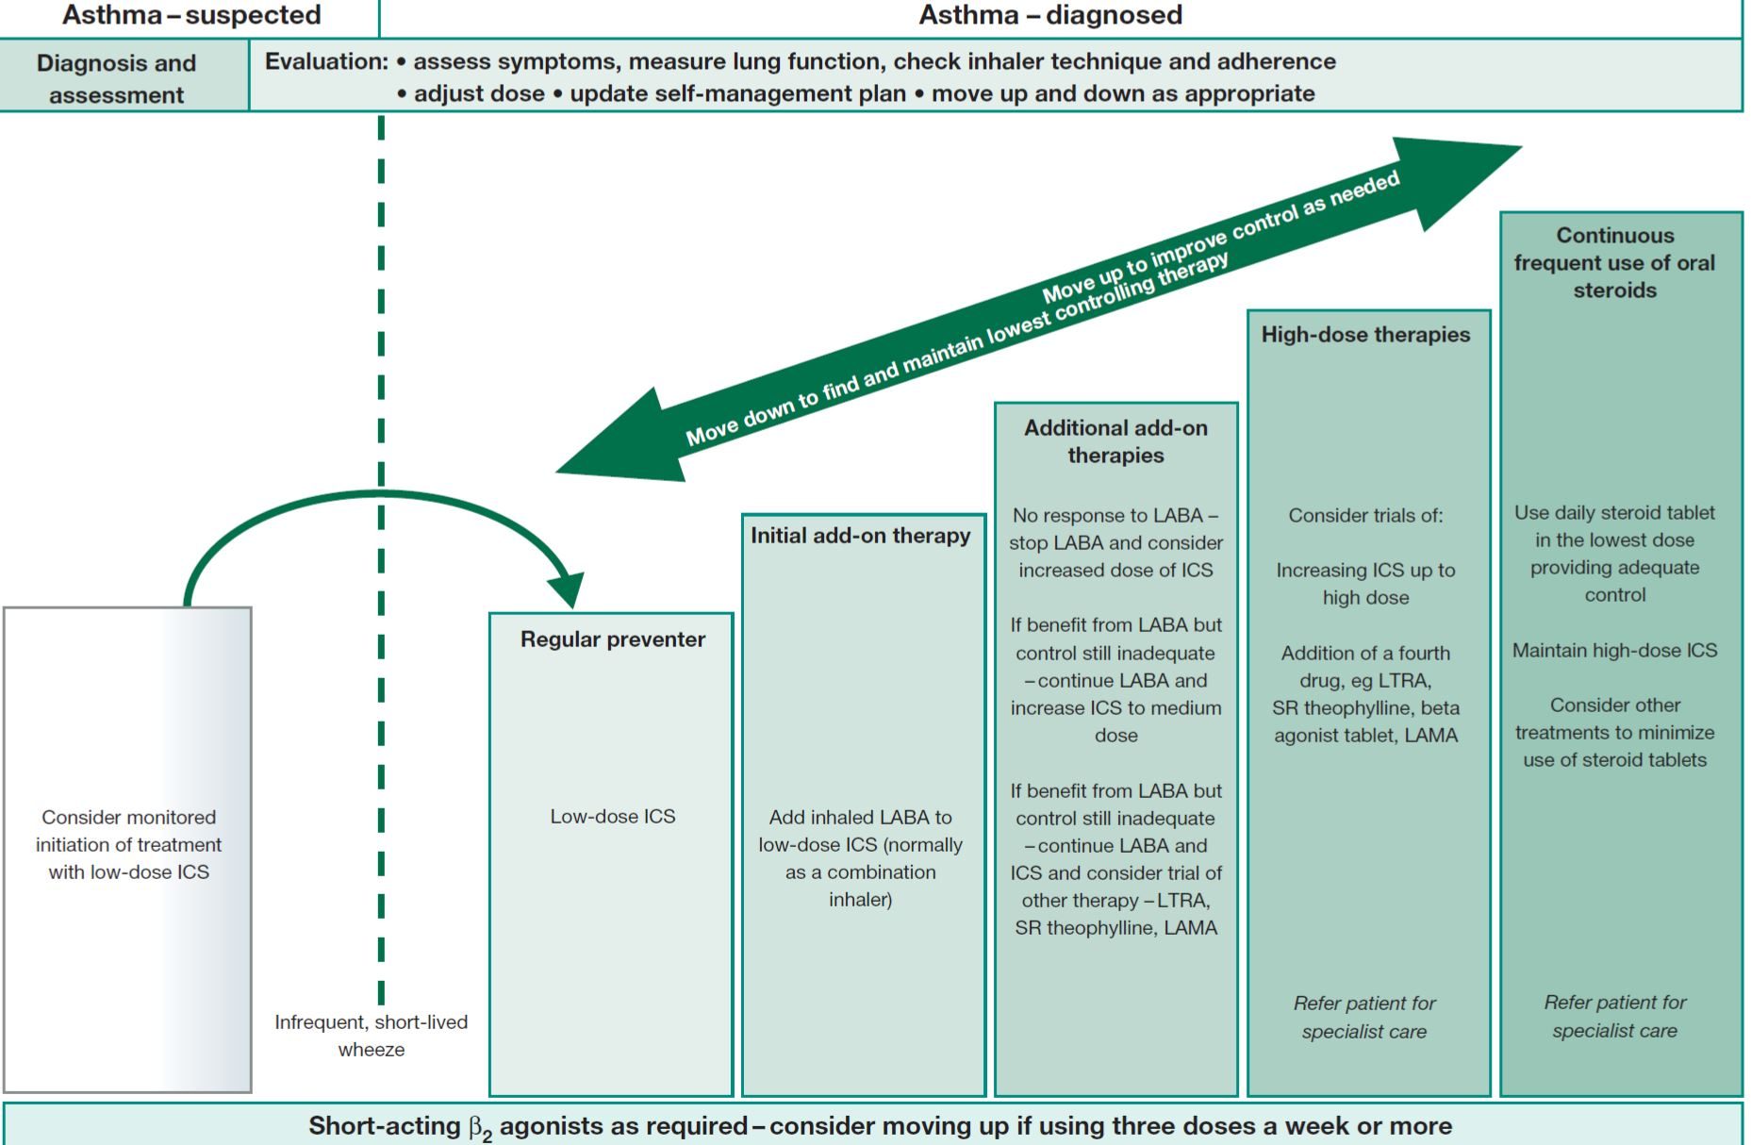
University of Basrah Al-zahra college of medicine
Ministry of higher Education and Scientific Research

Slide 18
University of Basrah Al-zahra college of medicine
Ministry of higher Education and Scientific Research
Chronic obstructive airway disease :
Chronic obstructive pulmonary disease (COPD) is a chronic lung disease defined by persistent respiratory symptoms and airflow limitation or obstruction that is not fully reversible.
Cigarette smoking represents the most significant risk factor for COPD and the risk of developing the condition relates to both the amount and duration of smoking. It is unusual to develop COPD with less
than 10 pack years

Slide 19
University of Basrah Al-zahra college of medicine
Ministry of higher Education and Scientific Research
Pathophysiology of COPD

Slide 20
University of Basrah Al-zahra college of medicine
Ministry of higher Education and Scientific Research
Clinical features:
COPD should be suspected in any patient over the age of 40 years who presents with symptoms of chronic bronchitis and/or breathlessness
Investigation:
Spirometry
Others.

Slide 21
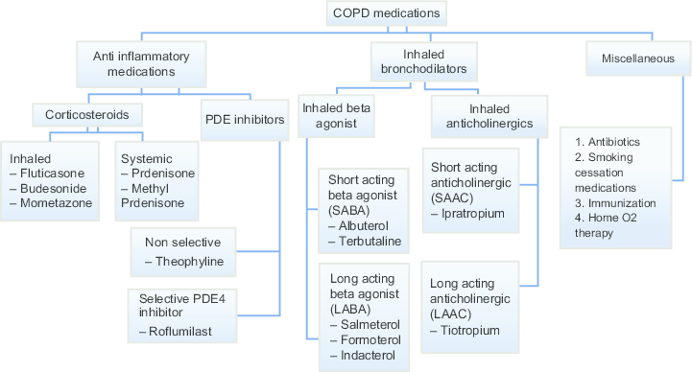
University of Basrah Al-zahra college of medicine
Ministry of higher Education and Scientific Research

Slide 22
University of Basrah Al-zahra college of medicine
Ministry of higher Education and Scientific Research
Some clinical uses of anti- muscarinic drugs :
Example | Organ | Uses :
Atropin | CNS | Preansthetic Badycardia , antispasmodic
Hyosine | GIT and CNS | antispasmodic
benzotropine | CNS | Parkinson disease
tropicamide | eye | Examination of fundscope
Oxybutinin | Urinary tract | Urinary urgency and incontence

Slide 23
University of Basrah Al-zahra college of medicine
Ministry of higher Education and Scientific Research
Thank you

